Slide 1
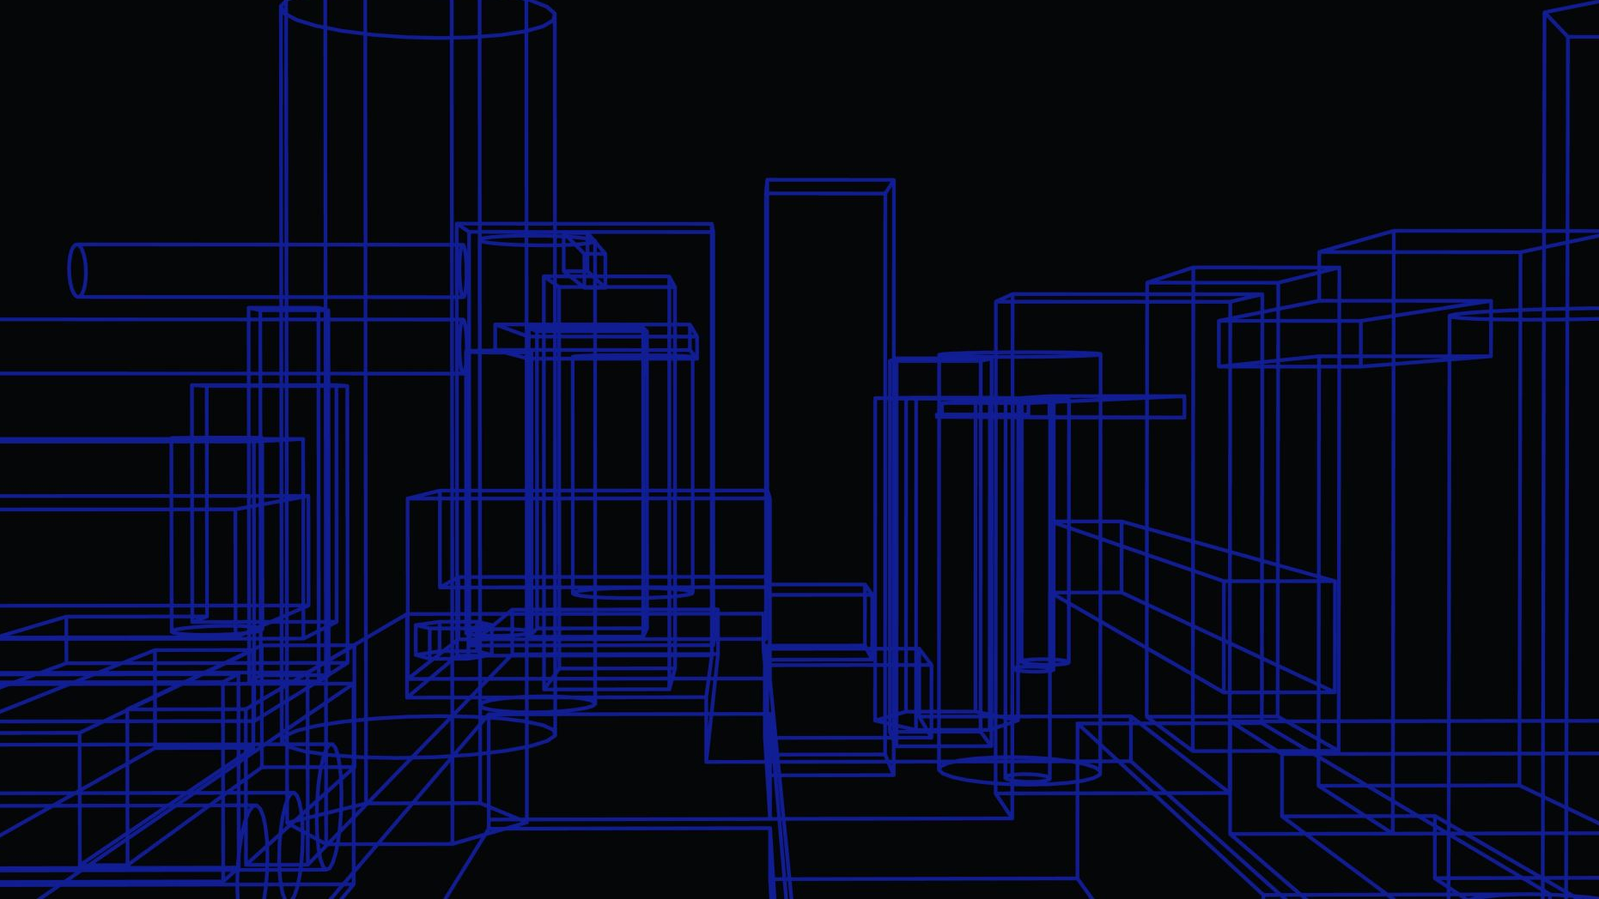
Predicting Rain Patterns in Australia
Justin Grisanti

Slide 2
Objectives – 5 Step Model
Obtain a Business Understanding
Understand the Data
Prepare Data for Modeling
Create Models
Generate Results

Slide 3
Business Understanding
Stakeholders:
Australian Government
Citizens of Australia
Firefighters of Australia
Business Problem:
To understand which attributes best predict whether or not it will rain the next day
Predictive Classification Model

Slide 4
Data Understanding
Various Weather Data
Wind Patterns
Sunshine Data
Cloud Data
Humidity
Temperature
Etc.
Histograms of Columns

Slide 5
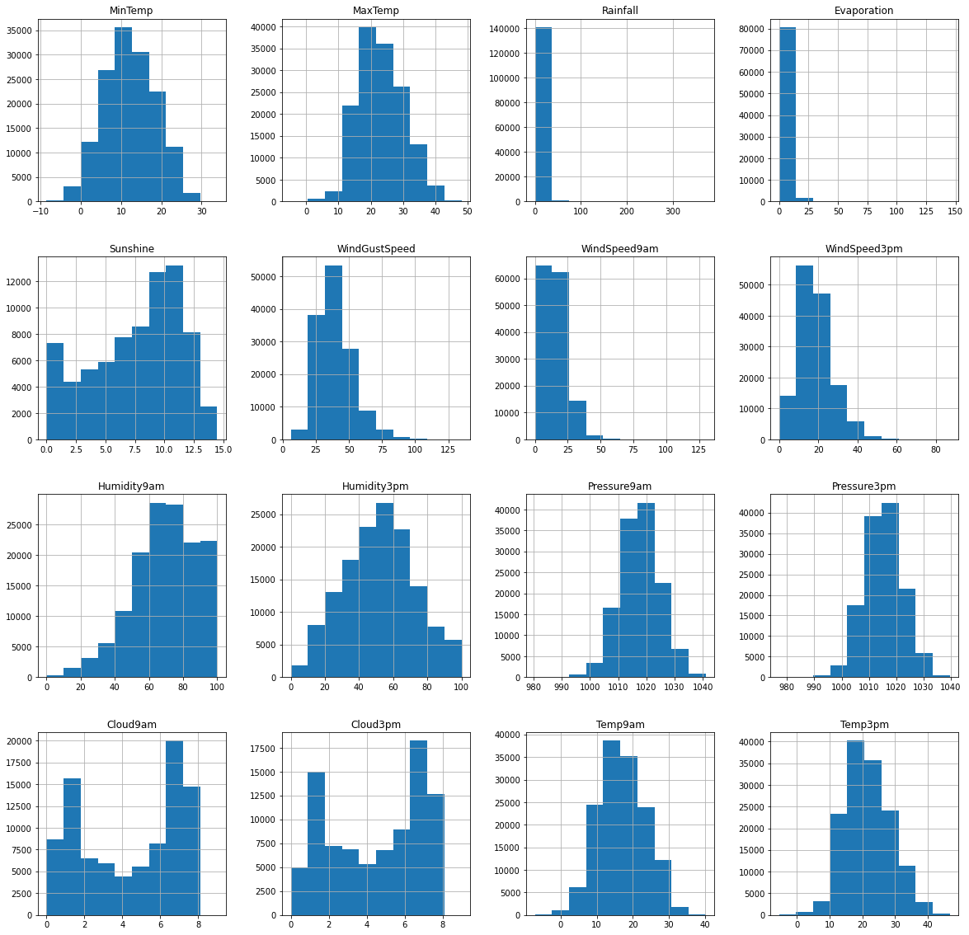

Slide 7
Data Preparation
Create Dummy Variables
Train and Test Split:
Fill empty data
Check for erroneous data
Normalize data
Clean all columns to ensure better modeling
Notes:
Gives our categorical variables numeric meaning

Slide 8
Modeling
Logistic Regression
Best Model: 84.19% Accurate
K-Nearest Neighbors
Best Model: 81.21% Accurate
Decision Trees
Best Model: 82.44% Accurate

Slide 9
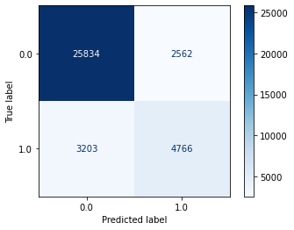
Logistic Regression: Confusion Matrix
84% Accurate
7% Type I Error
9% Type II Error

Slide 10
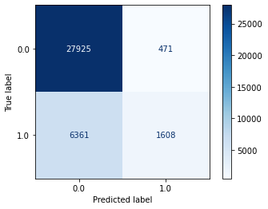
K-Nearest Neighbors: Confusion Matrix
81% Accurate
1% Type I Error
18% Type II Error

Slide 11
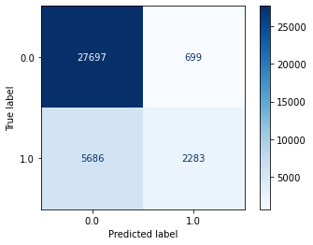
Decision Trees: Confusion Matrix
82% Accurate
2% Type I Error
16% Type II Error

Slide 12
Results
Best Model: Logistic Regression with an 84% Accuracy Score
Precision: 65%
Recall: 60%
AUC: .86
kNN and Decision Trees have less Type I error but more Type II Error
Notes:
Precision: If our model says that it will rain tomorrow, there is a 65% chance that it is a class 1 and will actually rain the next day.
Recall: If a given cell of rain data for the next day really is class 1, there is about a 60% chance that our model will label it correctly.
AUC: Our AUC Score is .86. That means that our classifiers have an 86% true positive rate. Our model seems sufficient at predicting whether or not it will rain, and that it isn’t classifying in a random manner.

Slide 13
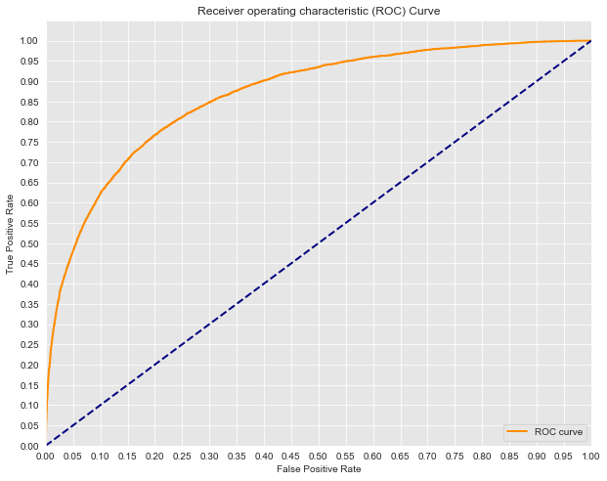

Slide 14
Next Steps:
Find more rain data in different periods and see how it performs
Try a Random Forest Model
Test more attributes in GridSearchCV

Slide 15
Thank you for your time!

